Slide 1
Chapter 11 Inheritance and Polymorphism

Slide 2
Polymorphism
Polymorphism means that a variable of a supertype can refer to a subtype object.
A class defines a type. A type defined by a subclass is called a subtype, and a type defined by its superclass is called a supertype. Therefore, you can say that Circle is a subtype of GeometricObject and GeometricObject is a supertype for Circle.
PolymorphismDemo
Run

Slide 3
Polymorphism, Dynamic Binding and Generic Programming
public class PolymorphismDemo {
public static void main(String[] args) {
m(new GraduateStudent());
m(new Student());
m(new Person());
m(new Object());
}
public static void m(Object x) {
System.out.println(x.toString());
}
}
class GraduateStudent extends Student {
}
class Student extends Person {
public String toString() {
return "Student";
}
}
class Person extends Object {
public String toString() {
return "Person";
}
}
Method m takes a parameter of the Object type. You can invoke it with any object.
An object of a subtype can be used wherever its supertype value is required. This feature is known as polymorphism.
When the method m(Object x) is executed, the argument x’s toString method is invoked. x may be an instance of GraduateStudent, Student, Person, or Object. Classes GraduateStudent, Student, Person, and Object have their own implementation of the toString method. Which implementation is used will be determined dynamically by the Java Virtual Machine at runtime. This capability is known as dynamic binding.
DynamicBindingDemo
Run

Slide 4

The ArrayList Class
You can create an array to store objects. But the array’s size is fixed once the array is created. Java provides the ArrayList class that can be used to store an unlimited number of objects.

Slide 5
Generic Type
ArrayList is known as a generic class with a generic type E. You can specify a concrete type to replace E when creating an ArrayList. For example, the following statement creates an ArrayList and assigns its reference to variable cities. This ArrayList object can be used to store strings.
ArrayList<String> cities = new ArrayList<String>();
ArrayList<String> cities = new ArrayList<>();
TestArrayList
Run

Slide 6

Differences and Similarities between Arrays and ArrayList
DistinctNumbers
Run

Slide 7
TestListArray.java
Pages 436-7 Listing 11.8

Slide 8
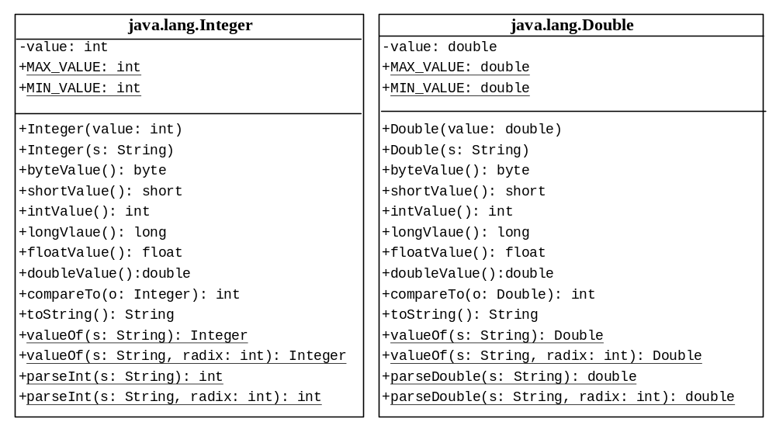
The Integer and Double Classes

Slide 9
The Integer Class and the Double Class
Constructors
Class Constants MAX_VALUE, MIN_VALUE
Conversion Methods

Slide 10
Numeric Wrapper Class Constructors
You can construct a wrapper object either from a primitive data type value or from a string representing the numeric value. The constructors for Integer and Double are:
  public Integer(int value)
  public Integer(String s)
  public Double(double value)
  public Double(String s)

Slide 11
Numeric Wrapper Class Constants
Each numerical wrapper class has the constants MAX_VALUE and MIN_VALUE. MAX_VALUE represents the maximum value of the corresponding primitive data type. For Byte, Short, Integer, and Long, MIN_VALUE represents the minimum byte, short, int, and long values. For Float and Double, MIN_VALUE represents the minimum positive float and double values. The following statements display the maximum integer (2,147,483,647), the minimum positive float (1.4E-45), and the maximum double floating-point number (1.79769313486231570e+308d).

Slide 12
DistinctNumbers.java
Pages 438-9 Listing 11.9

